Slide 1
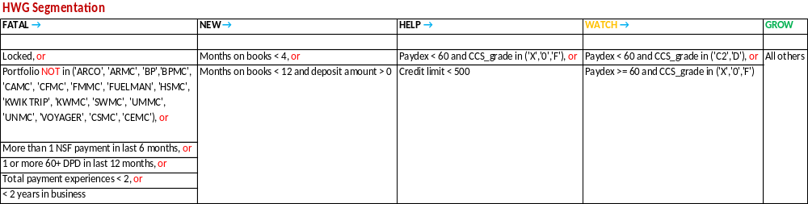
Companion Card Eligibility for Cross Sell
CC Eligible
WATCH
GROW
WATCH_1A
On books less than 12 months
Max DPD last 12months < 10
No NSF payment last 6 months
Fuel active last 90 days
GROW 1A1D
Unlocked
No Companion Card
On Book >= 12 Months
No 10+ DPD Last 12 Months
No NSF payment Last 6 Months
Fuel active last 90 days
GROW 1E
Unlocked
Non-Fuel inactive over 90 days
Fuel active last 90 days
GROW 2A
Max DPD last 12months >= 10
DPD <= 29 & past due amount <= 500
No NSF payment last 6 months
Fuel active last 90 days
FLEETCOR | 1

Slide 2
New/Additional Segmentation and Eligibility Criteria
Account Risk Segmentation Model
Decision tree segmentation model for classifying risk
Accounts for bureau credit history and Fleetcor performance
Places accounts in segments 1-63 based on risk
Segment 1 is lowest risk
Segment 63 is highest risk
Additional Eligibility Criteria
At least 3 cleared payments with total payment >= $2500
No more than 1 30+ DPD and no 60+ DPD in 12 months
Not in risk segment score 48-63
Not in GROW_1A_1D with MOB < 16
Not in WATCH_1A when CCS Grade D or X and Paydex Missing or < 80
Not linked to WO accounts
FLEETCOR | 2

